Slide 1
Digital Portfolio
STUDENT NAME: PRAKASH
REGISTER NO AND NMID: 2422k2213&AF2C6BC061C6FB1B5304E05CF457BE54
DEPARTMENT: Computer science
COLLEGE: Puratchi Thalaivi Amma govt arts and science College

Slide 2
PROJECT TITLE: PRAKASH portfolio

Slide 3


AGENDA
Problem Statement
Project Overview
End Users
Tools and Technologies
Portfolio design and Layout
Features and Functionality
Results and Screenshots
Conclusion
Github Link
3/21/2024 Annual Review

Slide 4

PROBLEM STATEMENT Students often struggle to present their academic achievements, skills, and projects in a structured and professional manner. Traditional resumes fail to capture creativity, practical skills, and hands-on experiences, making it difficult for students to stand out in academic or career opportunities. There is a need for a digital portfolio solution that allows students to effectively showcase their competencies, projects, and growth.

Slide 5

PROJECT OVERVIEW By developing this portfolio system, students will have a personalized digital identity that goes beyond a traditional CV, enhancing their chances of securing opportunities in competitive environments. It will also provide academic institutions and recruiters with a reliable and holistic view of a student’s potential

Slide 6

WHO ARE THE END USERS?
Primary End Users: Students Secondary End Users: Employers, recruiters, faculty, mentors, admission officers

Slide 7

TOOLS AND TECHNIQUES
Tools: trebedit Techniques: html,css,java script

Slide 8
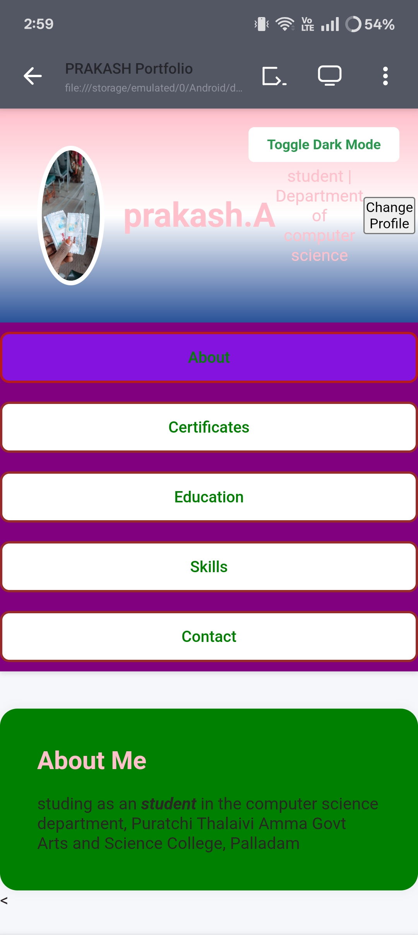
POTFOLIO DESIGN AND LAYOUT
8

Slide 9
FEATURES AND FUNCTIONALITY
🔴 About
🔴 Certificate
🔴 Education
🔴Skill
🔴 Contact
🔴 About:
In this folder show about me like what I study and which college etc..
🔴 Certificate:
The folder certificate represent what I finished in edunet skill build course
🔴 Education:
In this,it's show what is my level of education or what I study now
🔴Skill:
List technical and soft skills
🔴 Contact:
Email, phone or contact number and my details

Slide 10
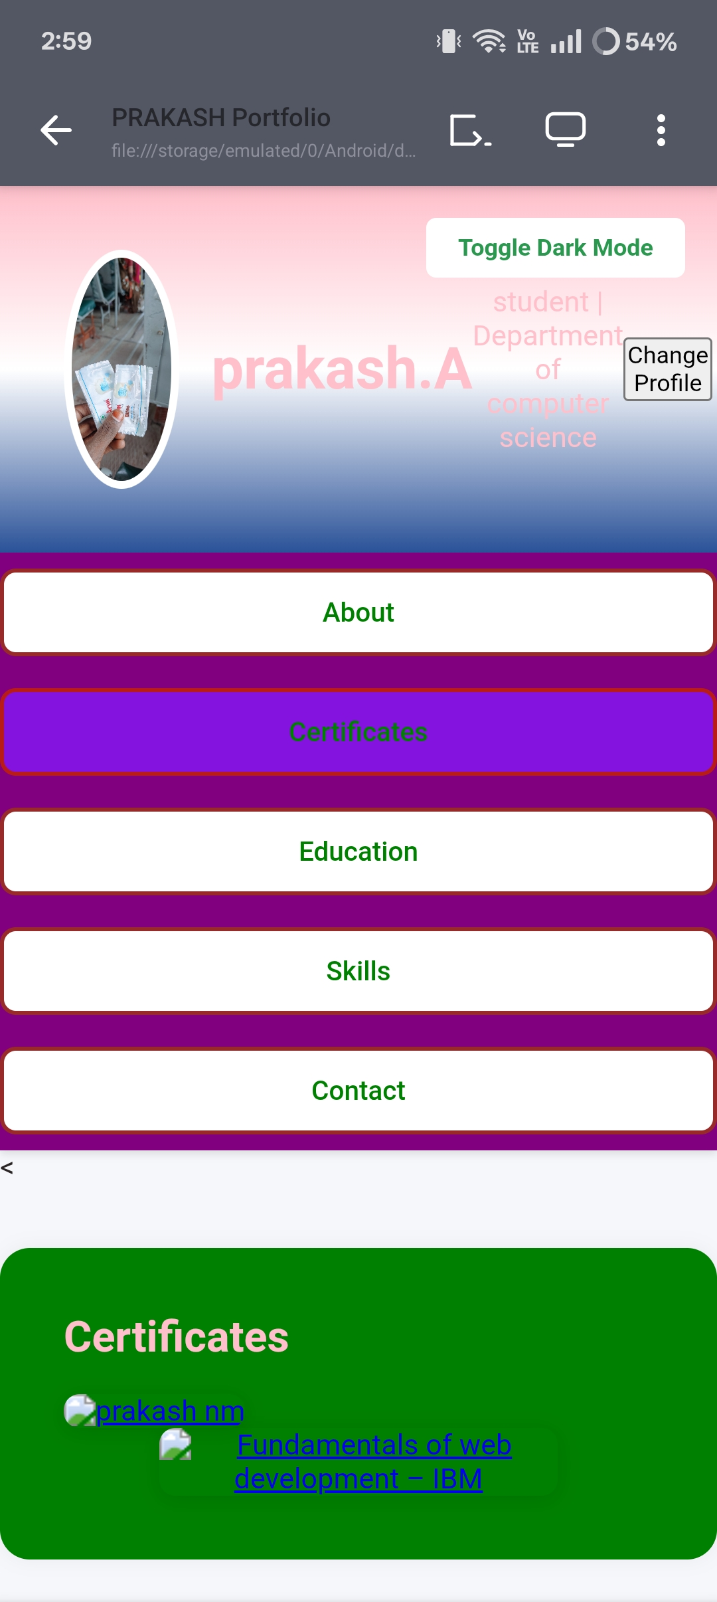
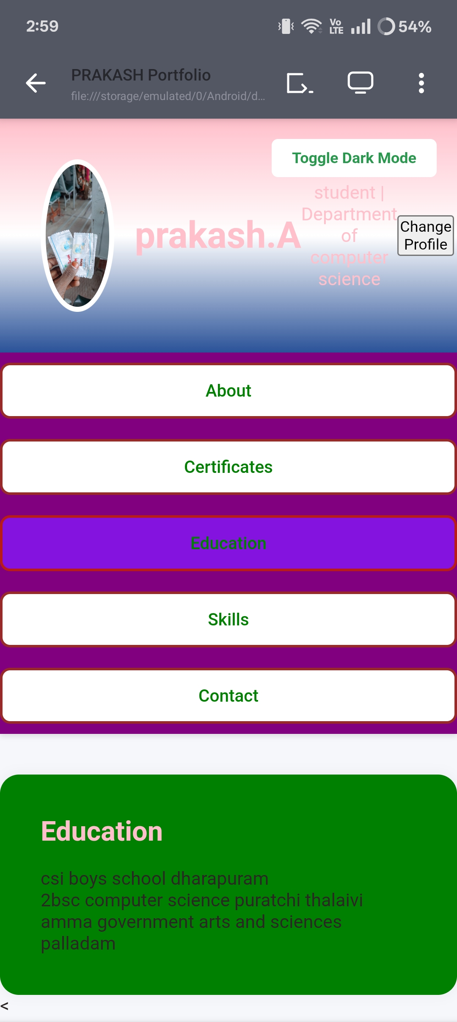

RESULTS AND SCREENSHOTS
3/21/2024 Annual Review
10

Slide 11
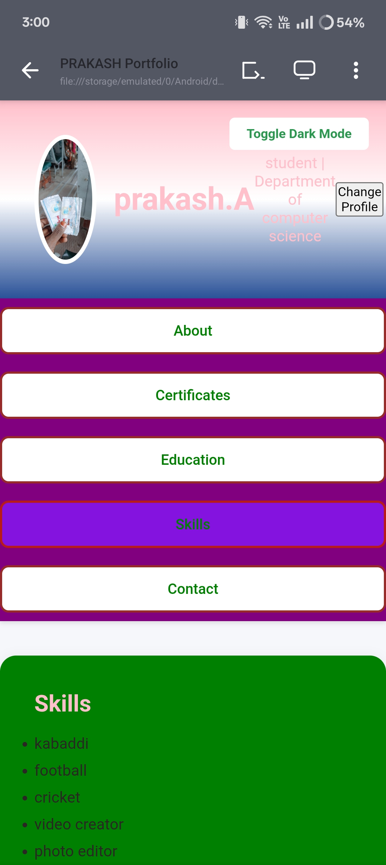
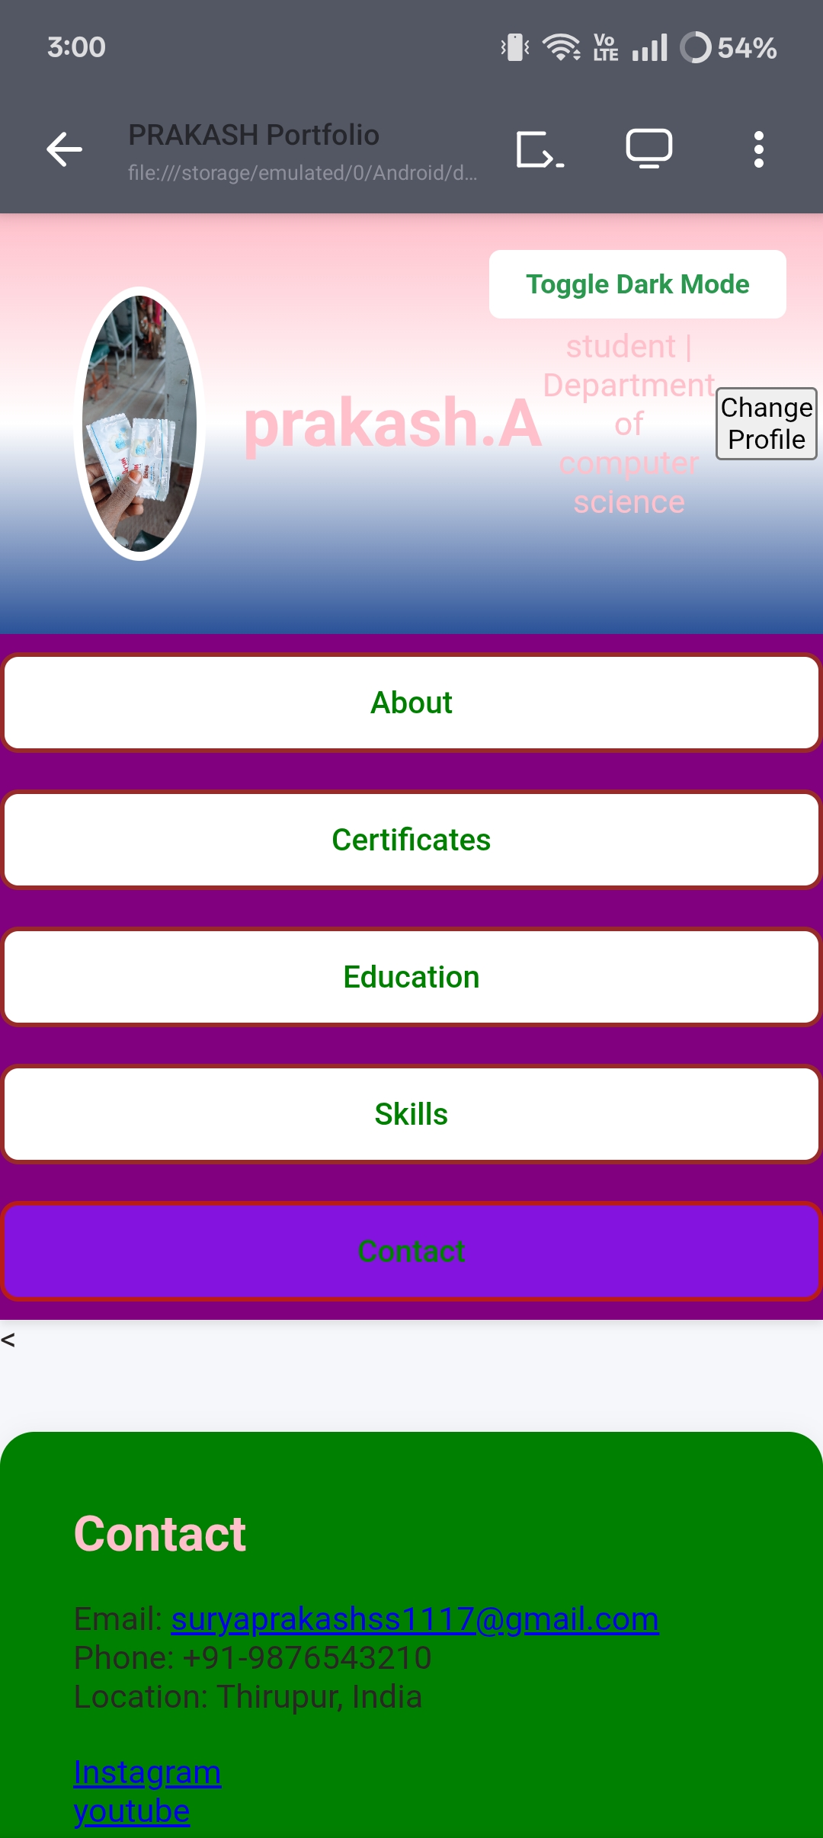

Slide 12
CONCLUSION
The development of the portfolio project successfully achieved its goal of creating a professional, user-friendly, and visually appealing platform to showcase skills, projects, and experiences. The responsive design ensures accessibility across various devices, while the integration of multimedia elements and third-party links enhances the portfolio's effectiveness and reach.
12

